Slide 1
Fog-mediated data sharing for IoT platforms
Sponsor - CMU CyLab, Qarnot Computing Points of contact - Yuan Tian, Emmanuel Owusu Faculty Advisor - Patrick Tague
Team - Aditya Subrahmanyan, Sumana Potturu and Yuehao Yuan

Slide 2
Agenda
● Project overview
Motivation
Proposed solution
● Project goals
Planned tasks and methodology
Criteria for evaluating the outcome
● Project progress and health
Theory/technology applied
Techniques under construction and progress
System design and development progress
● Future tasks

Slide 3
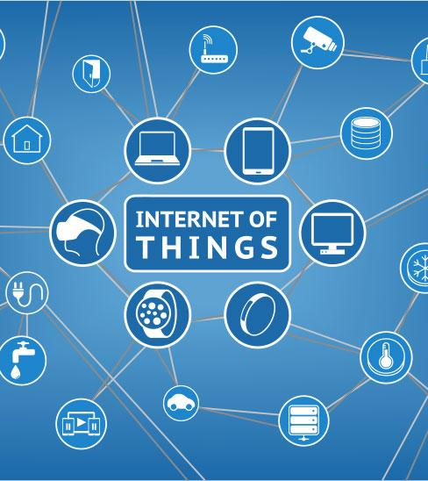
Internet of Things
Allows sensing, monitoring and control of objects using network infrastructure
Enables integration of physical world into computer systems
Allows for task automation and user-specific functionalities
Basis for ideas such as Smart Cities, Smart Homes, Smart Energy Management, etc.
Extremely rapid increase in number of connected devices, aka ‘Things’

Slide 4
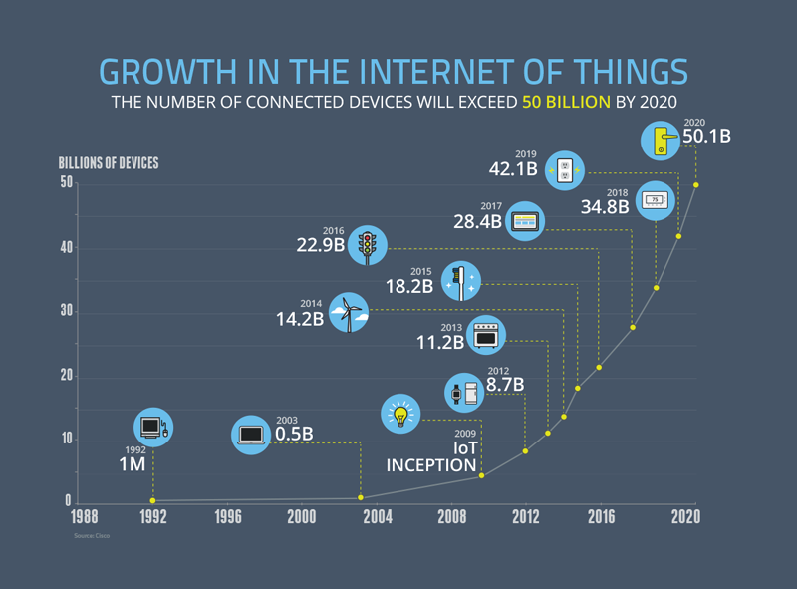
The past, the present and the future
Source: https://www.ncta.com/platform/broadband-internet/behind-the-numbers-growth-in-the-internet-of-things/

Slide 5
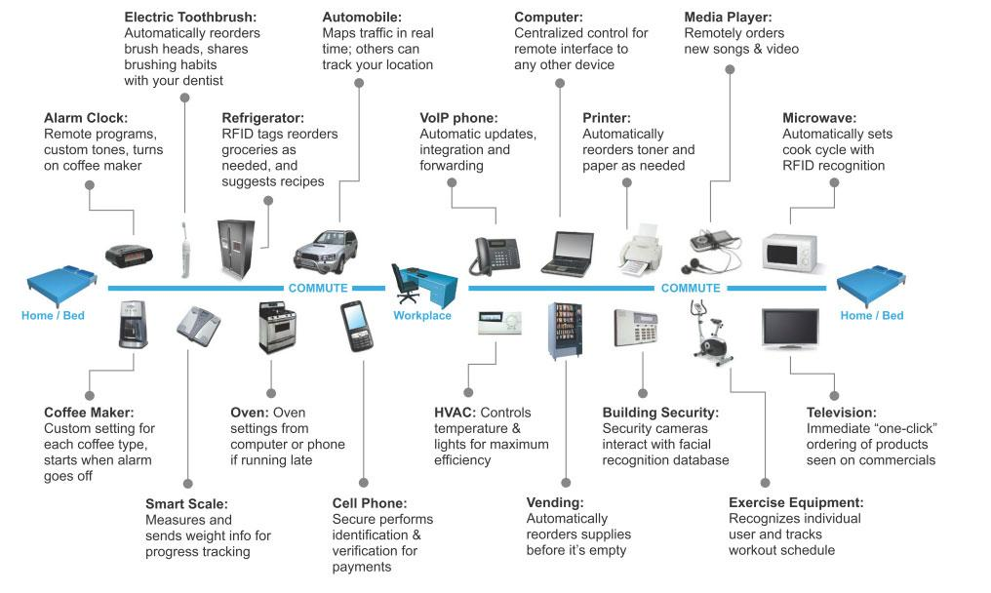
A day in the life of ...
Source: http://www.qualitydigest.com/inside/quality-insider-article/experiencing-quality-internet-things.html

Slide 6
Project motivation
IoT is increasingly targeted towards automation, user-specific functionality
Improve quality of life and ease tasks for individuals
Adapt to user requirements and behavioral patterns
Basic currency of IoT - Data
Continuous aggregation and processing of sensed information
‘Smart’ devices can also analyse and act upon the data
Issues in the current cloud-based model
IoT data generation rate and volume are extremely high
Latency and bandwidth constraints of network infrastructure
Not easy to obtain quick inferences from sensed data for realtime actions
Possible privacy violations due to transfer of user-specific data

Slide 7
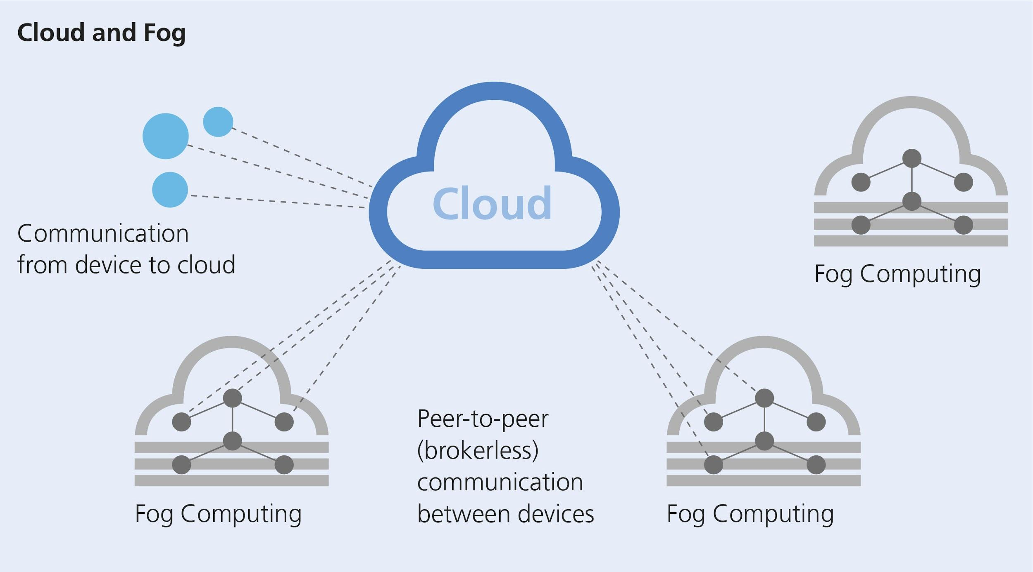
Proposed solution
“Develop and evaluate a fog-computing based, privacy-preserving data-sharing service for IoT platforms”
Fog computing
Use of nodes at the edge of a network for computation, storage and networking
Allows for quicker actions on sensed data
Reduces latency and burden on network infrastructure
Avoids need to exchange all data with central remote server(s)
Privacy-preserving machine learning
Every node is required to make ‘smart’ decisions based on the sensed data [machine learning]
Share training model parameters with other fog nodes without sharing all of the private user data

Slide 8

Project Goals
Preserve User Privacy

Slide 9

Project Tasks and Methodology
Determining application use case
Privacy-preserving speech recognition training model
Designing privacy-preserving server queries
Text independent speaker identification [Tentative]

Slide 10
Project Tasks and Methodology
Speech recognition
CMUSphinx - Open source speech recognition toolkit
Speech recognition model training using privacy-preserving deep learning
Designing queries
CoreNLP - Natural Language Processing tool
API to design server queries
Accuracy evaluation of speech recognition model

Slide 11
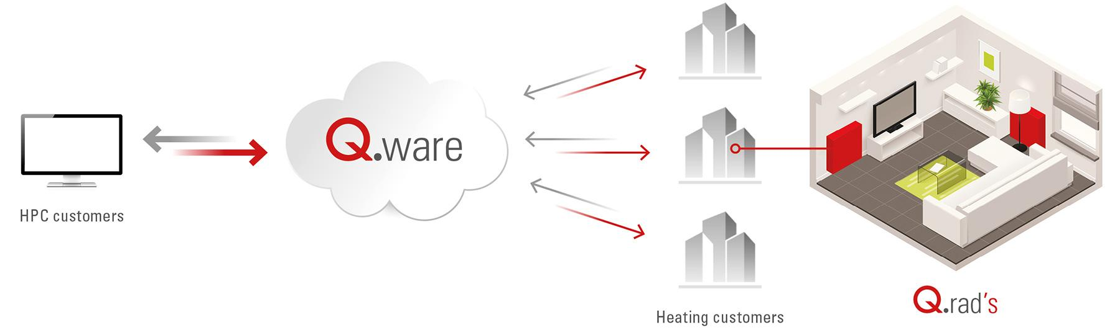
Project Tasks and Methodology
Platform setup for Application use case
Explore Qarnot platform
Build Docker images and deploy on Q.Rad
Add TPM support to Qarnot nodes [Tentative]
AWS setup
Docker Instance
Docker Image

Slide 12
Evaluation Criteria
Successful deployment of the application on Qarnot
Highly accurate speech recognition model
Designed queries should protect user privacy

Slide 13
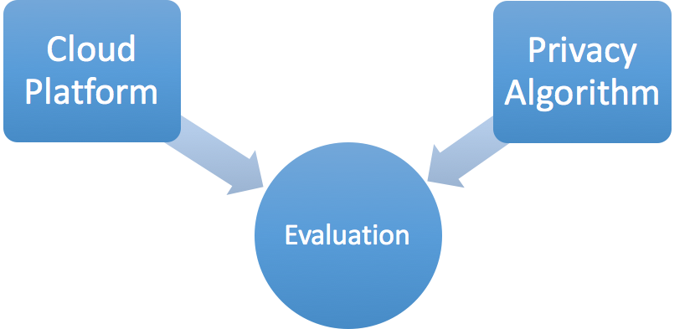
Project Progress & Health

Slide 14
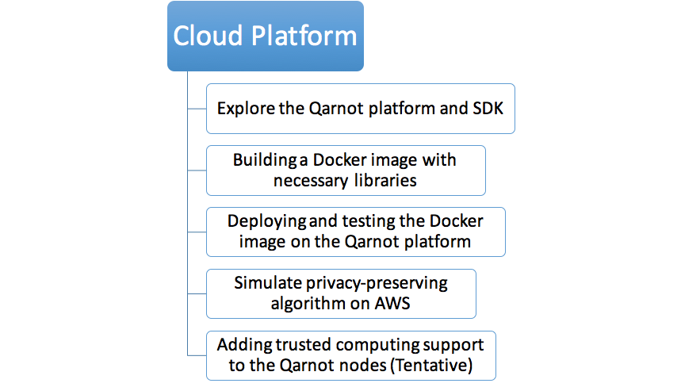






Project progress & Health

Slide 15
Project progress & Health
Explore the Qarnot platform and SDK
Run sample programs to submit tasks, work with files, docker hub
Provide feedback to Qarnot for issues/bugs encountered with the SDK
Build customised docker image with necessary speech recognition libraries
Install libraries on local Linux image
Commit and push modified image to docker hub
Deploy and test customised docker image on Qarnot platform
Pull docker image from docker hub
Deploy and run on Qarnot platform

Slide 16
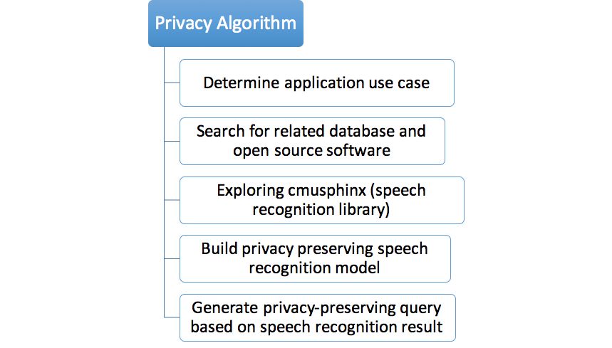
Project progress & Health

Slide 17
Project progress & Health
Determine application use case
Privacy preserving speech recognition
Search for related database and open source software
CMUsphinx
CoreNLP
Exploring CMUSphinx (speech recognition library)
Install PocketSphinx and Xphinx4 locally and successfully run samples

Slide 18
Future Tasks
Cloud
Simulate privacy-preserving algorithm on AWS (10/26)
Adding trusted computing support to the Qarnot nodes (Tentative) (11/09)
Privacy Algorithm
Build privacy preserving speech recognition model (10/26)
Generate privacy-preserving query based on speech recognition (11/02)
Evaluation
Integration of all individual components on the Qarnot platform (11/16)
Evaluate performance based on accuracy & privacy (11/23)

Slide 19

Questions?

